Slide 1
Image Filtering
Presented by
Nasima Islam Bithi
0421312032

Slide 2
Image Filtering
Image Filtering is used for modifying an image like highlighting or removing certain features.
It includes smoothing, sharpening, and edge enhancement.
The matrix defining the neighborhood of the pixel is known as mask or kernel. The size of mask should be odd.
Neighborhood exceeds image boundary: zero padding or replication of border pixels.

Slide 3
Spatial Filtering and its types
Spatial Filtering technique is used directly on pixels of an image.
Spatial filtering
Low pass filtering
(Smoothing)
High pass filtering
(Sharpening)
Linear filter
Non-Linear filter
Linear filter
Non-Linear filter
Box filter
Gaussian filter
Median filter
Min filter
Max filter
Laplacian filter
Unsharp mask
Roberts
Sobel
Prewitt

Slide 4

Linear and Nonlinear filters
A linear filter replaces each pixel with a weighted sum of its neighbors.
10×0 + 5×0 + 3×0 + 4×0 + 6×0.5 + 1×0 + 1×0 + 1×1 + 8×0.5 = 8
10 | 5 | 3
4 | 6 | 1
1 | 1 | 8
0 | 0 | 0
0 | 0.5 | 0
0 | 1 | 0.5
 | 8
Input Image
3×3 mask
Filtered Image
A Nonlinear filter operates by ranking the pixels in the specified neighborhood.
E.g., median filter, max filter, min filter
Max(10,5,3,4,6,1,1,1,8)
10 | 5 | 3
4 | 6 | 1
1 | 1 | 8
 | 10
Max Filter
Filtered Image
Input Image

Slide 5
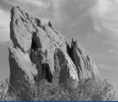
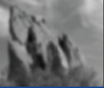
Smoothing Filter
Low pass filter. G(u, v) = H(u, v) . F(u, v)
The weights of mask must be positive. Sum of weights is 1 (after normalization).
Removes high-frequency components (e.g. edges, boundaries, noise).
E.g., box filter, gaussian filter, median filter etc.
input image
smoothed image

Slide 6


Average Filter
Known as box filter or mean filter.
All weights are equal.
Mask size determines the degree of smoothing.
Effective in removing the noise but has the ringing effect.
$$\frac{1}{9}$$
1 | 1 | 1
1 | 1 | 1
1 | 1 | 1
$$\frac{1}{16}$$
1 | 1 | 1 | 1
1 | 1 | 1 | 1
1 | 1 | 1 | 1
1 | 1 | 1 | 1
3×3 box filter
4×4 box filter

Slide 7
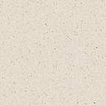
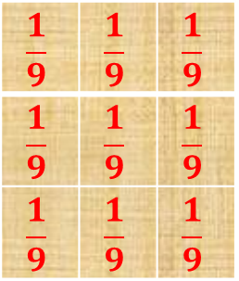
Example: Average Filter
Applying average filter with zero padding
0 | 0 | 0 | 0 | 0
0 | 0 | 5 | 4 | 0
0 | 7 | 120 | 5 | 0
0 | 4 | 3 | 7 | 0
0 | 0 | 0 | 0 | 0
$$\frac{1}{9}$$ | $$\frac{1}{9}$$ | $$\frac{1}{9}$$
$$\frac{1}{9}$$ | $$\frac{1}{9}$$ | $$\frac{1}{9}$$
$$\frac{1}{9}$$ | $$\frac{1}{9}$$ | $$\frac{1}{9}$$
0 | 5 | 4
7 | 120 | 5
4 | 3 | 7
15 | 16 | 15
15 | 17 | 16
15 | 16 | 15
Input Image
Filtered Image
Input Image with Zero Padding
3×3 box filter

Slide 8
Example: Average Filter
Applying average filter with pixel replication
0 | 0 | 5 | 4 | 4
0 | 0 | 5 | 4 | 4
7 | 7 | 120 | 5 | 5
4 | 4 | 3 | 7 | 7
4 | 4 | 3 | 7 | 7
$$\frac{1}{9}$$ | $$\frac{1}{9}$$ | $$\frac{1}{9}$$
$$\frac{1}{9}$$ | $$\frac{1}{9}$$ | $$\frac{1}{9}$$
$$\frac{1}{9}$$ | $$\frac{1}{9}$$ | $$\frac{1}{9}$$
0 | 5 | 4
7 | 120 | 5
4 | 3 | 7
16 | 17 | 17
17 | 17 | 18
17 | 18 | 18
Input Image
Filtered Image
Input Image with pixel replication
3×3 box filter

Slide 9
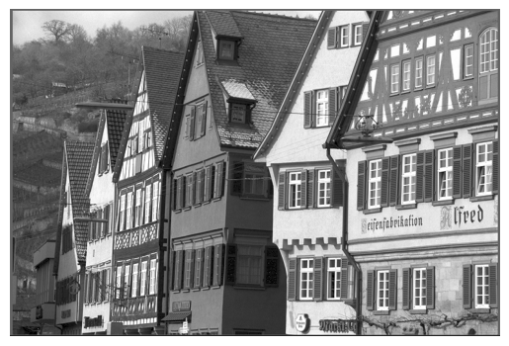



Effect of mask size
Input image
5x5 mask
25x25 mask
15x15 mask

Slide 10


Weighted Average Filter
The filter gives more weight to the nearby pixels than the distant ones.
It preserves edges while removing noise and produces images with fewer artifacts than box filter but is more costly to compute.
The mask is the approximation of 2D Gaussian function. So It is also known as the Gaussian filter. σ controls the amount of smoothing.
$$\frac{1}{16}$$
1 | 2 | 1
2 | 4 | 2
1 | 2 | 1
Gaussian
x = y = 5 σ
3×3 Gaussian filter

Slide 11
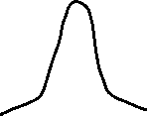



Effect of σ
If σ is smaller, the filter has a minimal effect (less blur) because the weights of neighbors are very small.
If σ is slightly larger, the filter can effectively remove some noise.
If the σ is too large, the filter performs similarly as the average filter.
Small σ
medium σ
lager σ
Very large σ
0 | 1 | 0
1 | 5 | 1
0 | 1 | 0
1 | 2 | 1
2 | 4 | 2
1 | 2 | 1
1 | 1.5 | 1
1.5 | 2 | 1.5
1 | 1.5 | 1
1 | 1 | 1
1 | 1 | 1
1 | 1 | 1

Slide 12
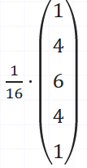
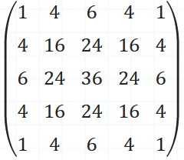


Gaussian kernel Generation
The Gaussian kernel can be obtained using Pascal’s Triangle (linearly separable). The normal distribution with μ = 0 and σ = 1/2.
For a 5x5 kernel, the sum is 1+4+6+4+1= 16.

Slide 13
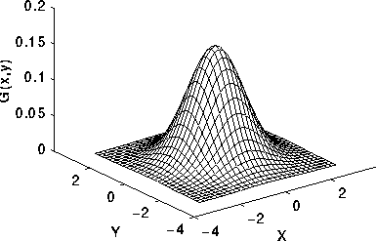
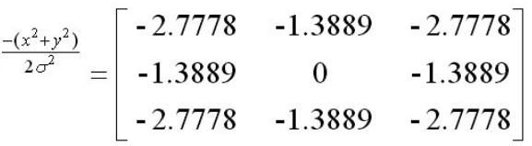
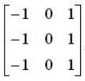
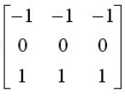

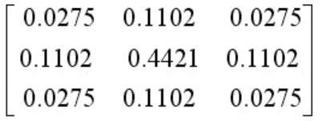

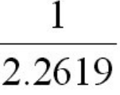
Gaussian kernel Generation
1. Formula to design 2D gaussian kernel:
2. Let σ = 0.6 and kernel size = 3x3.
x is the width and y is the height of the kernel.
x =
y =
=> Taylor series!
3. Calculate the weights of the kernel:
=

Slide 14
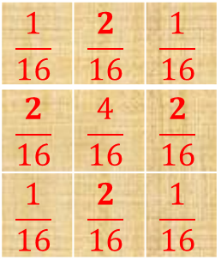
Example: Weighted Average Filter
Applying weighted average filter with zero padding
0 | 0 | 0 | 0 | 0
0 | 0 | 5 | 4 | 0
0 | 7 | 120 | 5 | 0
0 | 4 | 3 | 7 | 0
0 | 0 | 0 | 0 | 0
$$\frac{1}{16}$$ | $$\frac{2}{16}$$ | $$\frac{1}{16}$$
$$\frac{2}{16}$$ | $$\frac{4}{16}$$ | $$\frac{2}{16}$$
$$\frac{1}{16}$$ | $$\frac{2}{16}$$ | $$\frac{1}{16}$$
0 | 5 | 4
7 | 120 | 5
4 | 3 | 7
9 | 18 | 10
18 | 33 | 18
10 | 18 | 10
Input Image
Filtered Image
Input Image with Zero Padding
3×3 Gaussian filter

Slide 15
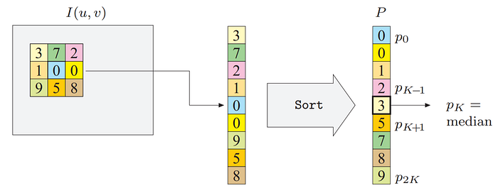
Median Filter
Replaces each pixel with the median in the neighborhood around the pixel.
Used for removing salt and pepper noise in the image (i.e., random occurrences of black and white pixels).
Preserves edges of an image while reducing the image noise.

Slide 16
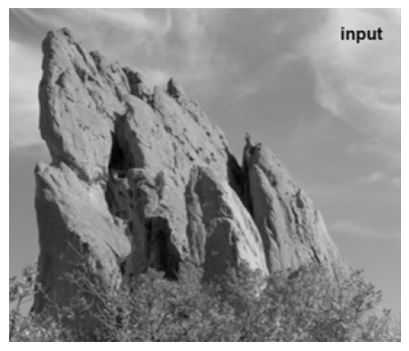
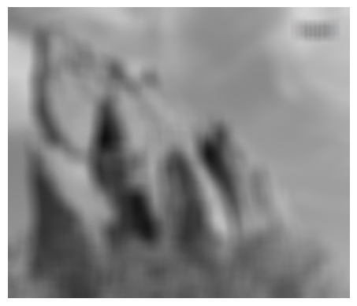

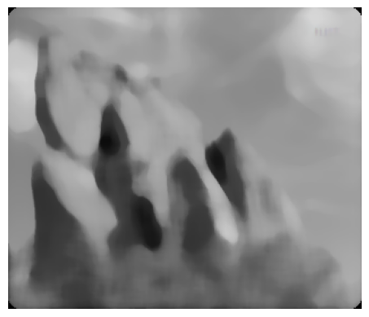
Example: Smoothing Filters
Input image
Box filtering
Gaussian filtering
Median filtering

Slide 17
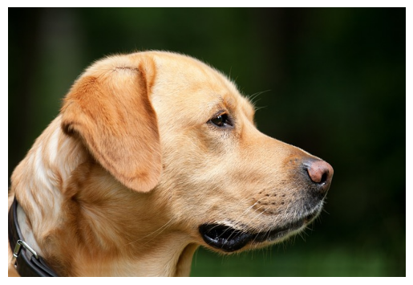
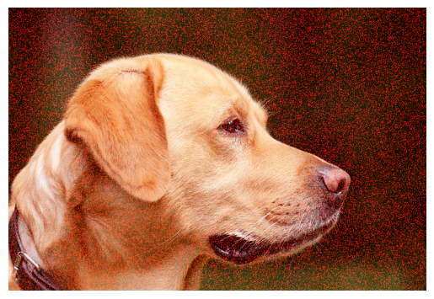

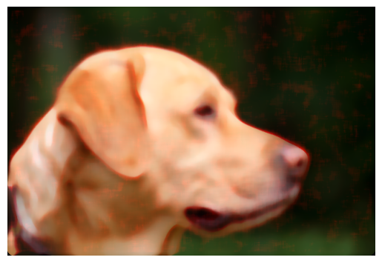

Image with Gaussian noise
Original image
Noisy image
Box filtering
Median filtering
Gaussian filtering

Slide 18
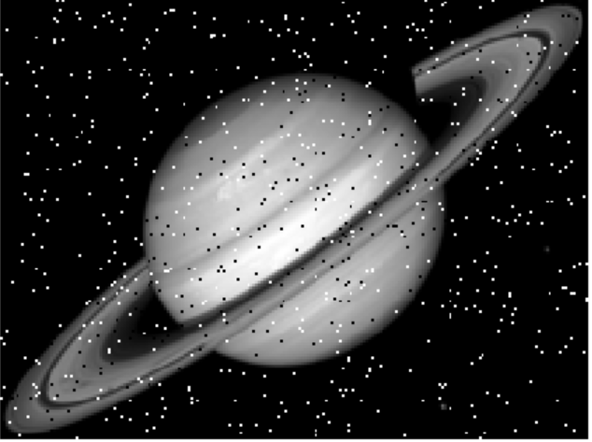
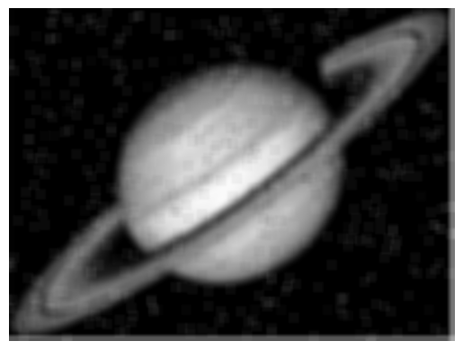
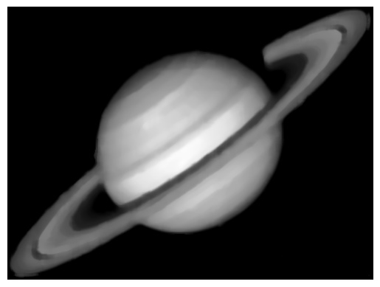

Image with salt & pepper noise
Input image
Box filtering
Median filtering
Gaussian filtering

Slide 19
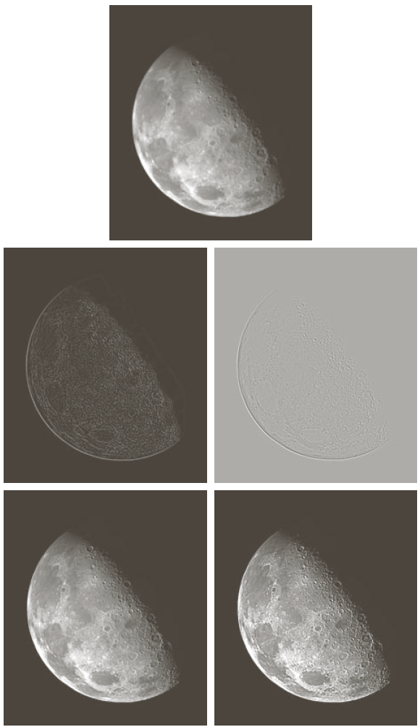
Sharpening Filters
High pass filter. H(u, v) = 1 – H'(u, v)
The weights of the mask can be both positive and negative. Sum of weights is 0.
Useful for highlighting edges, fine details and increasing contrast.
E.g. Unsharp masking, Gradient, Laplacian etc.
Input image
Sharpened image

Slide 20
References
https://www.mathworks.com/help/images/what-is-image-filtering-in-the-spatial-domain.html
https://medium.com/jun94-devpblog/cv-2-gaussian-and-median-filter-separable-2d-filter-2d11ee022c66
https://www.imageeprocessing.com/2014/04/gaussian-filter-without-using-matlab.html

